Slide 1
Oil Recovery Mechanisms & Material Balance Equation

Slide 2
Oil Recovery Mechanisms
All reservoirs are unique.
The recovery of oil by any of the natural drive mechanisms is called primary recovery.
They can be grouped according to the primary recovery mechanism by which they produce.
There are basically six driving mechanisms that provide the natural energy necessary for oil recovery :
1. Rock and liquid expansion drive
2. Depletion drive
3. Gas cap drive
4. Water drive
5. Gravity drainage drive
6. Combination drive

Slide 3
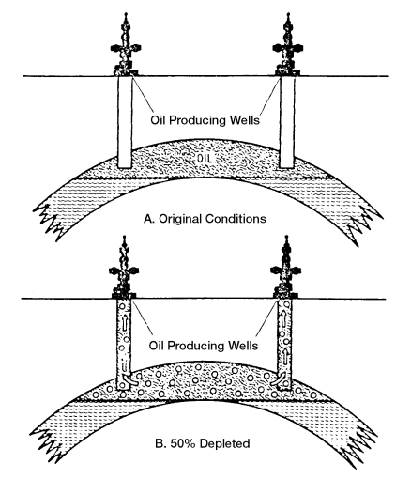
1. Rock and Liquid Expansion
For a undersaturated oil reservoir B.P.P. < P_{(reservoir)}
As the expansion of the fluids and reduction in the pore volume occur with decreasing reservoir pressure, the crude oil and water will be out of the pore space to the wellbore.
2. Depletion Drive Mechanism
The principal source of energy is a result of gas liberation from the crude oil.
As pressure falls below the bubble-point pressure, gas bubbles are liberated within the microscopic pore spaces.
These bubbles expand and force the crude oil out of the pore space as shown conceptually in Figure.

Slide 4
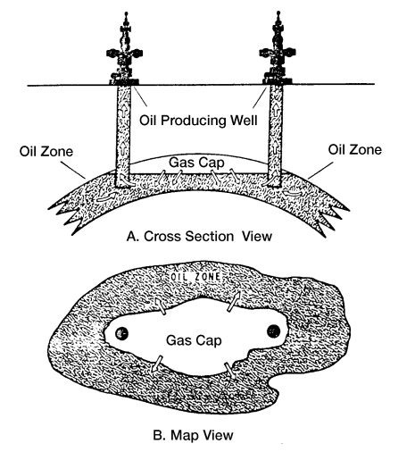
3. Gas Cap Drive Mechanism
Identified by the presence of a gas cap with little or no water.
The natural energy available to produce the crude oil comes from the following two sources :
1. Expansion of the gas-cap gas
2. Expansion of the solution gas as it is liberated.

Slide 5
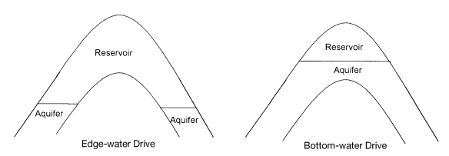
4. Water Drive Mechanism
Many reservoirs are bounded on a portion or all of their peripheries by water bearing rocks called aquifers.
The water drive is the result of water moving into the pore spaces originally occupied by oil, replacing the oil and displacing it to the producing wells

Slide 6
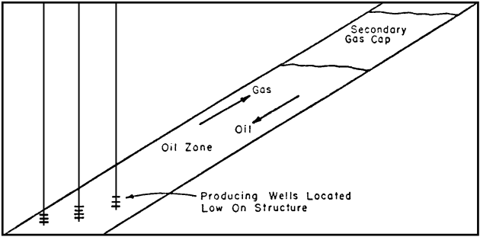
5. Gravity-Drainage-Drive Mechanism
The mechanism of gravity drainage occurs in petroleum reservoirs as a result of differences in densities of the reservoir fluids.
If the reservoir fluids are in equilibrium, then the gas-oil and oil-water contacts should be essentially horizontal.
In order to take maximum advantage of the gravity-drainage-producing mechanism, wells should be located as structurally low as possible. This will result in maximum conservation of the reservoir gas.

Slide 7
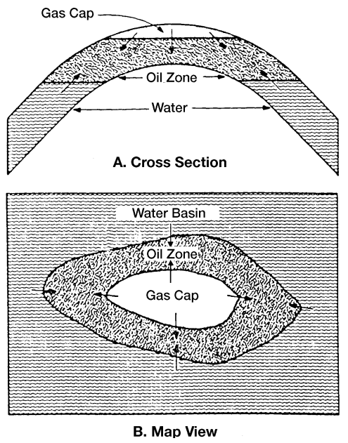
6. Combination Drive Mechanism
The driving mechanism most commonly encountered is one in which both water and free gas are available in some degree to displace the oil toward the producing wells.
Two combinations of driving forces can be present in combination drive reservoirs. These are 1. depletion drive and a weak water drive and 2. depletion drive with a small gas cap and a weak water drive.

Slide 8
Characteristics of different Driving Mechanisms
Characteristics | Rock and Liquid expansion | Depletion drive | Gas-cap drive | Water drive | Gravity drainage | Combination drive
Reservoir pressure | rapid decline | rapid decline | declines slowly | gradual decline | rapid decline | rapid decline
GOR | constant | rapidly increasing | rise continuously | slight change | low | increases
Water production | - | no | negligible | increases appreciably | little or no | slowly increasing
Ultimate oil recovery | small % | (5-30)% | (20-40)% | (35-75)% | >80% | (30-70)%

Slide 9
Material Balance Equation
The material balance equation (MBE) has long been recognized as one of the basic tools of reservoir engineers for interpreting and predicting reservoir performance.
The MBE, when properly applied, can be used to:
1.Estimate initial hydrocarbon volumes in place
2.Predict future reservoir performance
3.Predict ultimate hydrocarbon recovery under various types of primary driving mechanism
The equation is structured to simply keep inventory of all materials entering, leaving and accumulating in the reservoir.
Initial volume = volume remaining + volume removed

Slide 10
Basic Assumption in MBE:-
Constant Temperature
Pressure Equilibrium
Constant Reservoir volume
PVT data set are reliable and representative laboratory procedure has been used.
Reliable production data: Three production data are required – oil, gas and water.
V_{in}
V_{out}
V_{in} - V_{out} = V_{accumulate}

Slide 11
Application of material balance equation:-
Estimation of contributing hydrocarbon volume in place
Estimation Gas Cap or aquifer size
Determine pressure, type and size of an aquifer
Future reservoir performance prediction
Predict ultimate hydrocarbon recovery under various type of drive mechanism
We can see how pressure is declining and additional support is required or not.

Slide 12
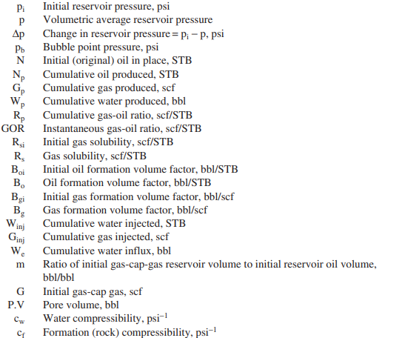
Standard nomenclature adopted by the Society of Petroleum Engineers:

Slide 13
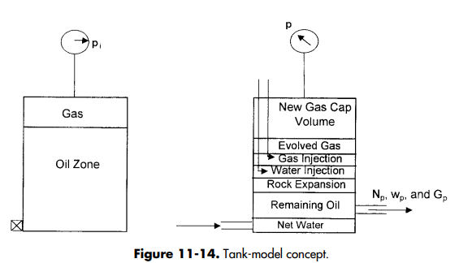
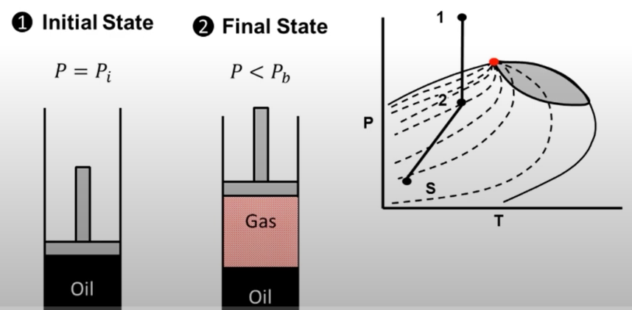
The MBE can be written in a generalized form as follows:

Slide 14
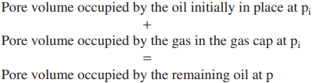
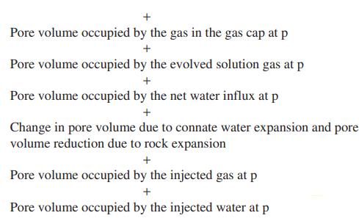

Slide 15
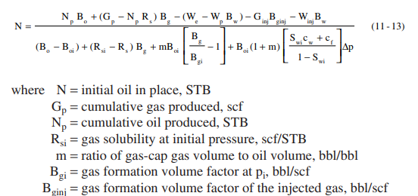
Material Balance Equation :

Slide 16
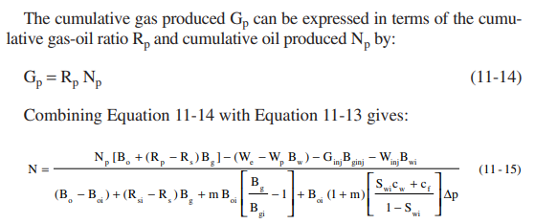
The Above relationship is referred to as the material balance equation.

Slide 17
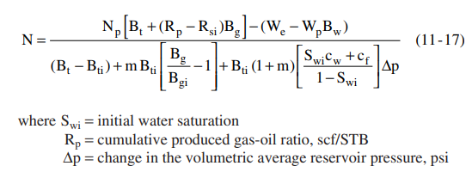
A more convenient form of the MBE can be created by using the concept of the total (two-phase) formation volume factor, Bt.

Slide 18
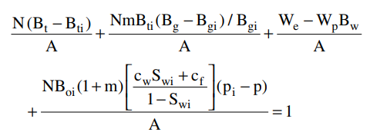
Taking A = Np [Bt + (Rp − Rsi) Bg]
MBE can be written as:

Slide 19
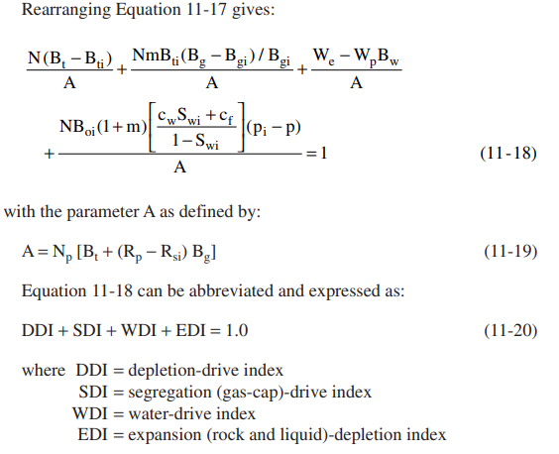
In a combination drive reservoir, it is important to determine the relative contribution of each driving mechanism to production.

Slide 20
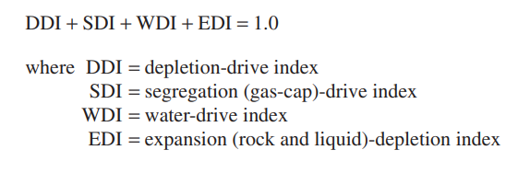
These represent the primary drive mechanism.
WDI = (We − Wp Bw)/A where WDI is termed the water-drive index.
SDI = [N m Bti (Bg − Bgi)/Bgi]/A where SDI is termed the segregation-drive index.
DDI = N (Bt − Bti)/A where DDI is termed the depletion-drive index.

Slide 21
There are essentially three unknowns in Equation 11-15:
a. The original oil in place, N
b. The cumulative water influx, We
c. The original size of the gas cap as compared to the oil zone size, m

Slide 22
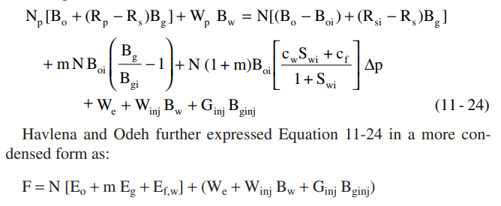
The MBE as an Equation of a Straight Line
In developing a methodology for determining the above three unknowns, Havlena and Odeh (1963) expressed in the following form:
• F represents the underground withdrawal
• Eo describes the expansion of oil and its originally dissolved gas
• Eg is the term describing the expansion of the gas-cap gas
• Ef,w represents the expansion of the initial water and the reduction in the pore volume

Slide 23
MBE as a straight line equation:
MBE is presented as :
F = N [Eo + m Eg + Ef,w] + (We + Winj Bw + Ginj Bginj)
Assuming no water or gas injection is done for pressure maintenance, W_{inj and} Ginj = 0
F = N [Eo + m Eg + Ef,w] + We
F represent the underground withdrawal
F = Np [Bo + (Rp − Rs) Bg] + Wp Bw
F = Np [Bt + (Rp − Rsi) Bg] + WpBw
• Eo describes the expansion of oil and its originally dissolved gas
Eo = (Bo − Boi) + (Rsi − Rs) Bg
Eo = Bt − Bti
• Eg is the term describing the expansion of the gas-cap gas
Eg = Boi [(Bg/Bgi) − 1]
Eg = Bti [(Bg/Bgi) − 1]

Slide 24

• Ef,w represents the expansion of the initial water and the reduction in the pore volume
Taking different assumption for different cases, MBE can be represented as a straight-line.

Slide 25
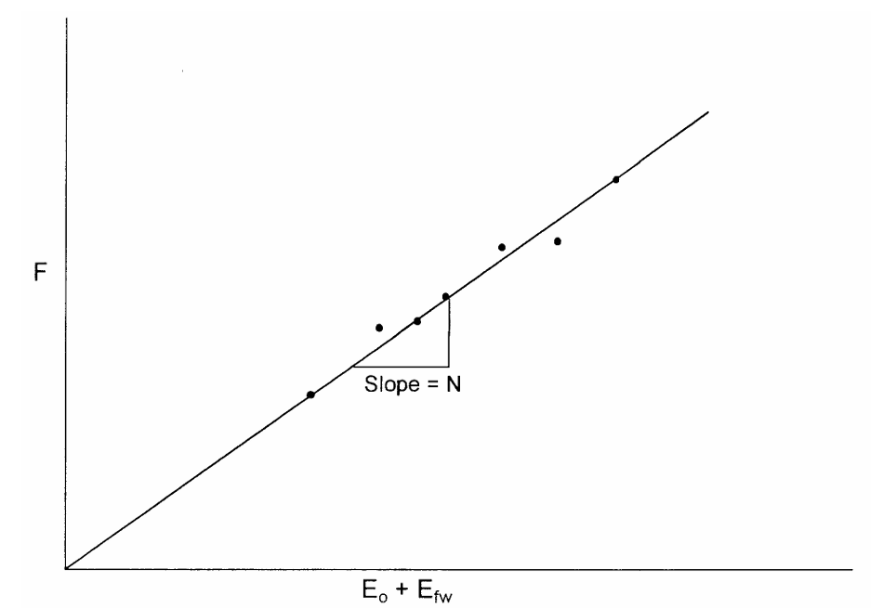
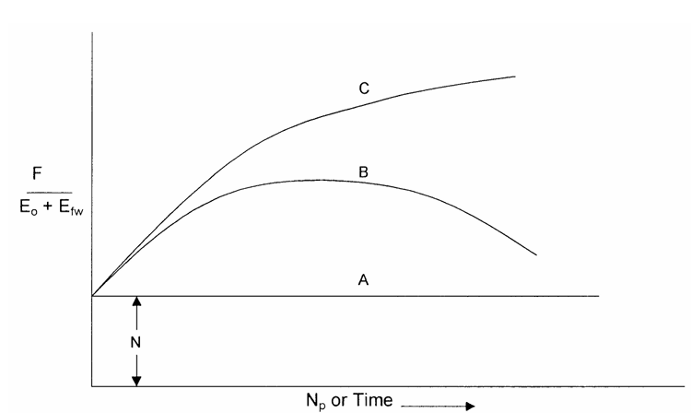
If the plot devites from straight line, then the assumptions are incorrect.
Case 1.Volumetric Undersaturated oil Reservoir:
• We = 0, since the reservoir is volumetric
• m = 0, since the reservoir is undersaturated
• Rs = Rsi = Rp, since all produced gas is dissolved in the oil
F = N (Eo + Ef,w)
Line A in the plot implies that the reser voir can be classified as a volumetric reservoir.
Curve C strong water-drive
curves B is weak water drive

Slide 26
Case 2. Volumetric Saturated-Oil Reservoirs
An oil reservoir that originally exists at bubble-point pressure is referred to as a saturated oil reservoir.
Assuming that water and rock expansion term Ef,w is negligible in comparison with the expansion of solution gas
No initial gas cap, so m=0
F = N [Eo + m Eg + Ef,w] + WeBw
This will reduced to F=NEo

Slide 27
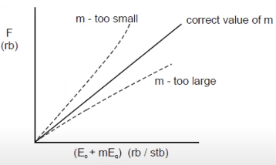
Case 3. Gas-Cap-Drive Reservoirs
Assumig that the natural water influx is negligible (We=0)
The effect of water and pore compressibilities can be considered negligible.
F = N [Eo + m Eg + Ef,w] + WeBw
This will reduced to : F=N[Eo + mEg]
There are three possible unknowns in above equation:
N is unknown, m is known
m is unknown, N is known
N and m are unknown

Slide 28
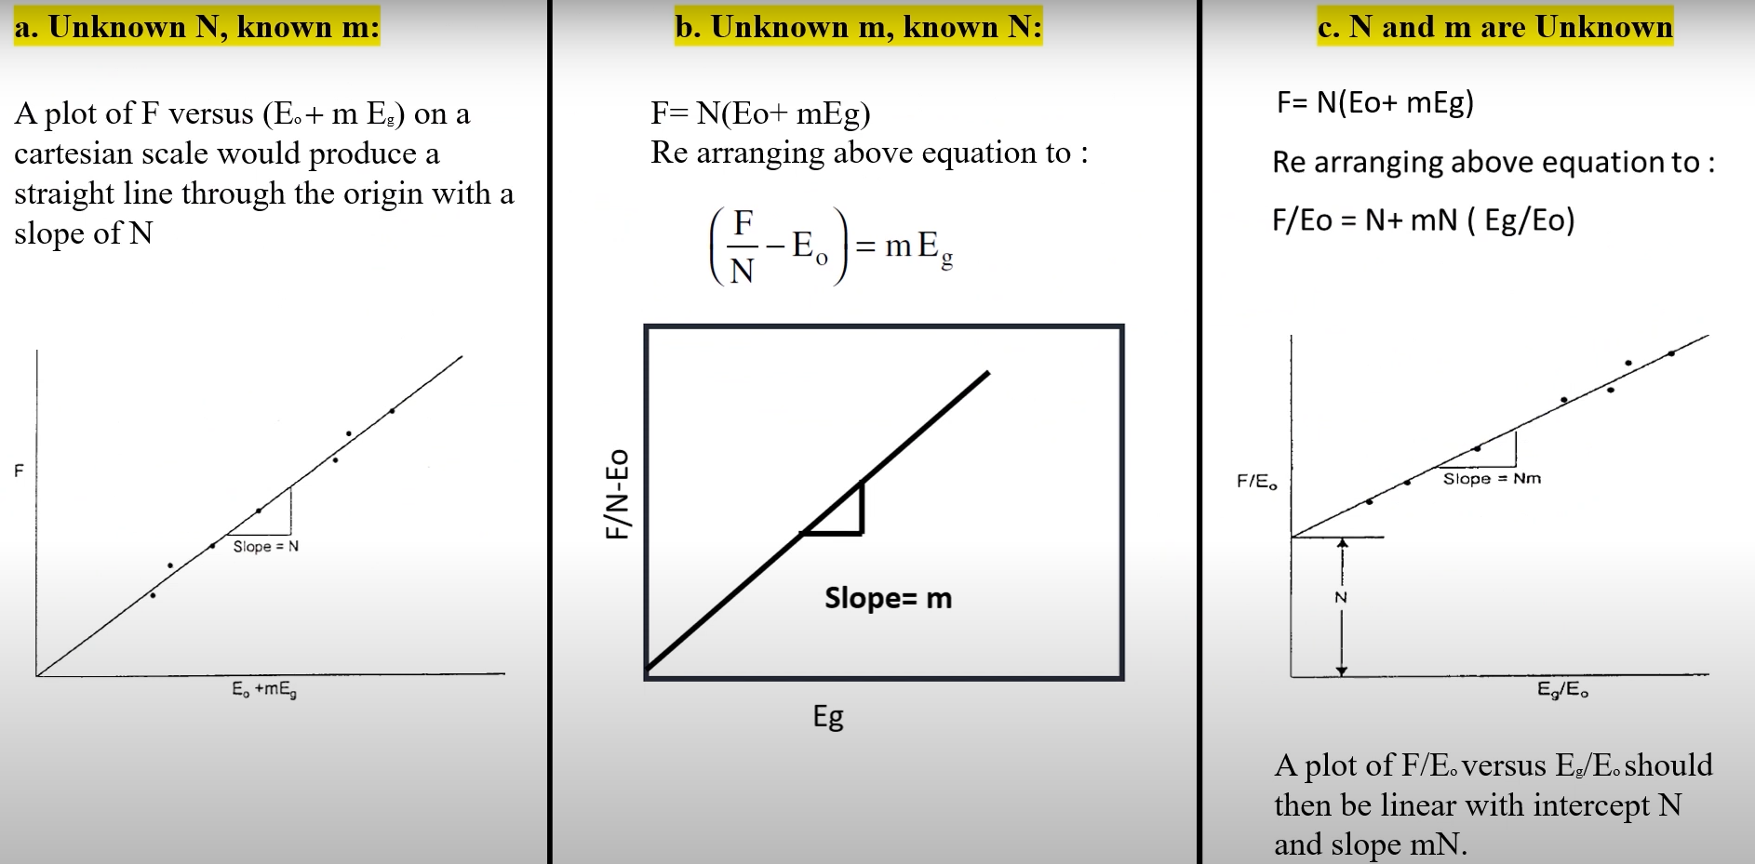

Slide 29
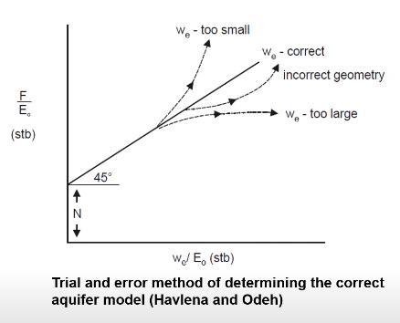
Case 4. Water-Drive Reservoirs
F = N [Eo + m Eg + Ef,w] + We
Ef,w can frequently be neglected in water-drive reservoirs
the reservoir has initial gas cap
F = N Eo + We
Several water influx models can be used:
Pot-aquifer model
Schilthuis steady-state method
Van Everdingen-Hurst model

Slide 30
Decline Curve Analysis

Slide 31
Introduction
Decline Curve Analysis (DCA) is a graphical representation of the production data.
DCA is used for
Analysing declining production rate
Forecasting future performance of oil and gas wells
Estimated Ultimate Recovery
NOTE : Fitting a line through production data and assuming that the trend will continue in the future remains the basis for DCA.

Slide 32
Assumptions
Drainage area is constant
Well produce at a constant Flowing bottom hole pressure
Skin factor is not changing with time
Limitation
Any past activities like change in the choke or Work-over jobs (W/O) will affect the future trend.

Slide 33
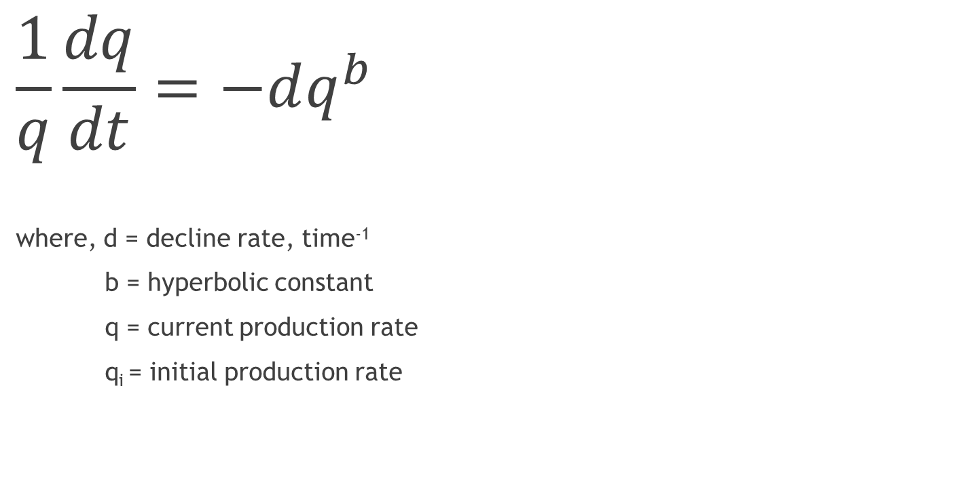
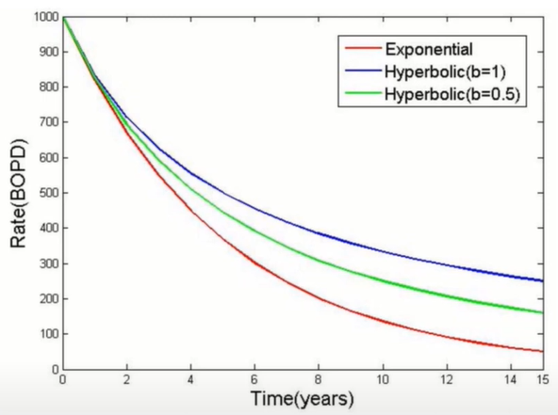
Types of Decline Curves

Slide 34
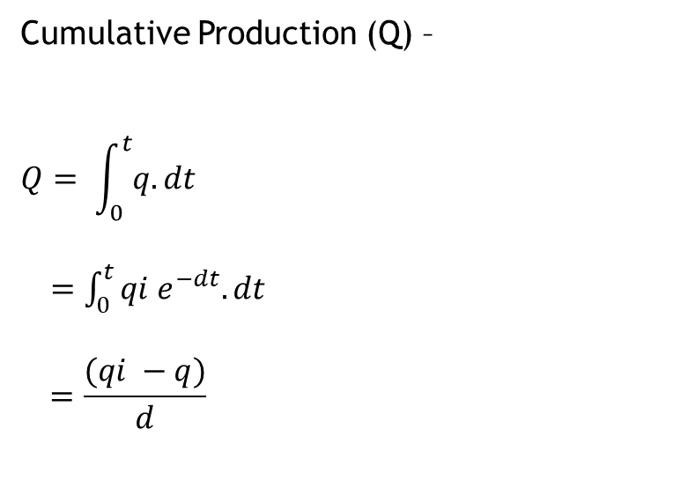
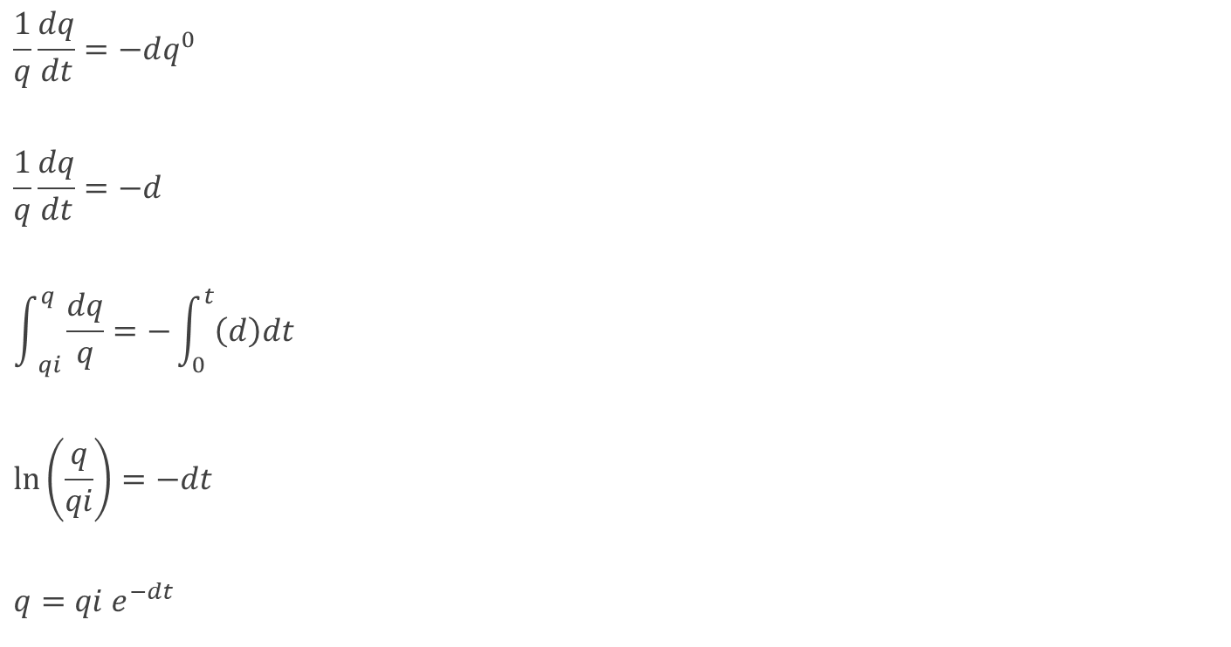
Derivation for exponential decline (b=0)

Slide 35
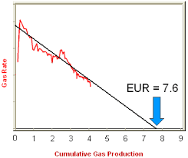
Estimate Ultimate Recovery
EUR = Q + Remaining reserve as per the trend obtained
Recovery Factor (RF) = EUR/OOIP

Slide 36
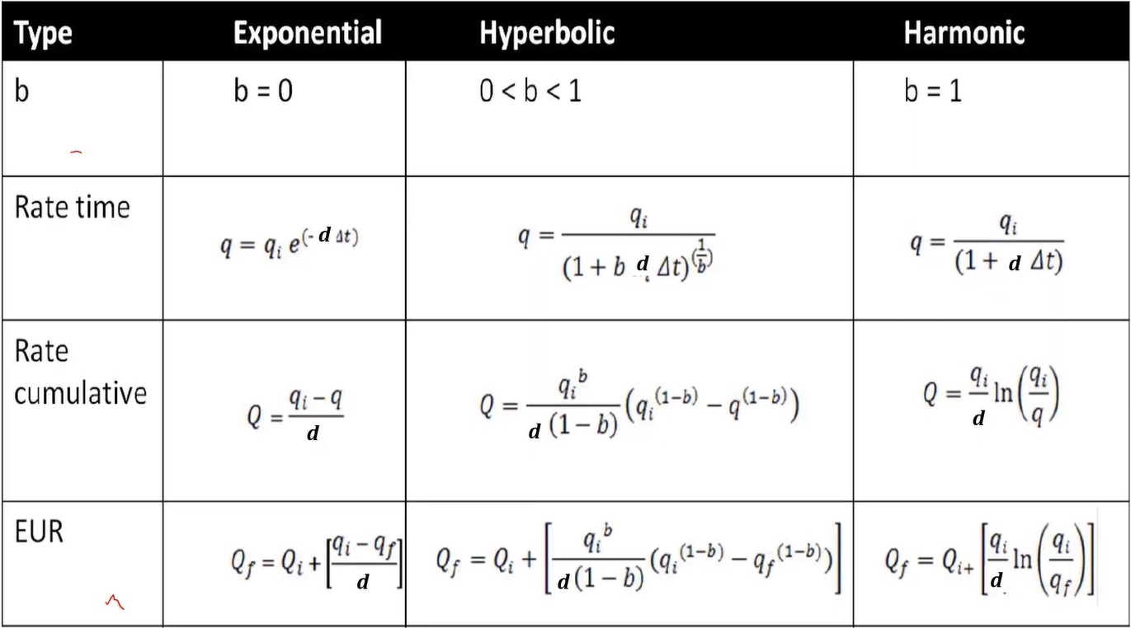

Slide 37
Identification of Decline Curve
Exponential decline :
Straight line will be observed for flow rate vs time in semi-log scale and on rate vs cumulative production on Cartesian scale.
Harmonic decline :
Straight line will be observed for flow rate vs cumulative production in semi-log scale.
Hyperbolic decline :
Straight line is not obtained for any type of curve.

Slide 38
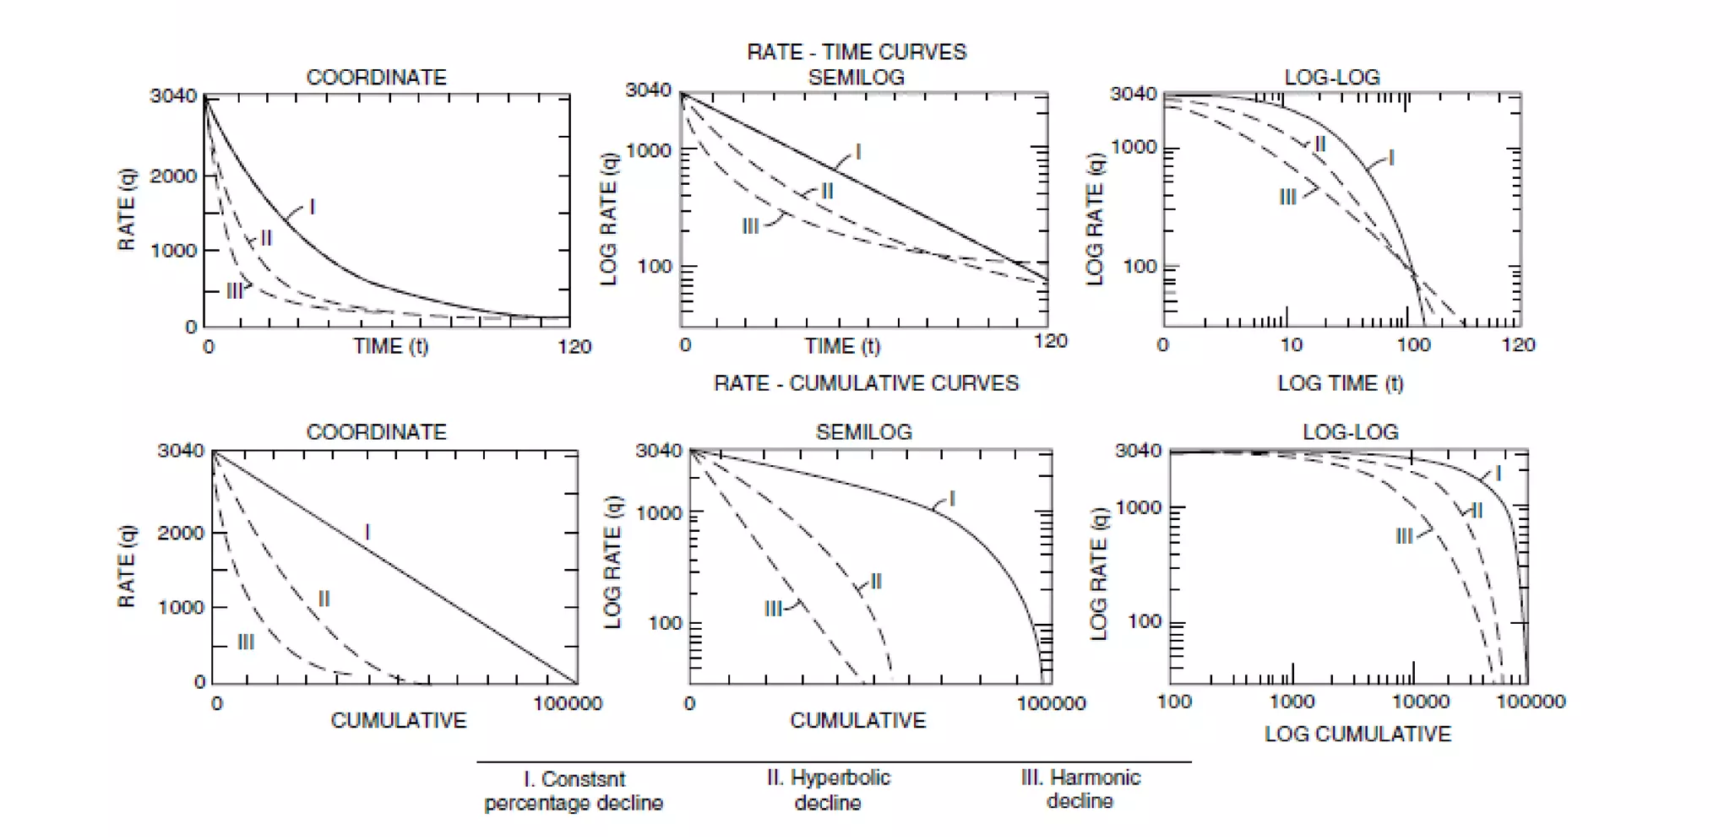

Slide 39


